Slide 1

Tobacco Use and Health Risks: Leveraging Big Data to Analyze Behavioral Patterns and Trends
Health Care Industry
Group 11

Slide 2
Team Members
Nandini
Vamshi
Vijay
Bala
Jaya Sai

Slide 3
Introduction
Data used in the project are BRFSS Survey Data extracted from the CDC's State Tobacco Activities Tracking and Evaluation (STATE) System.
The goal is to better understand the behavioral health consequences of tobacco use and find out the demographic characteristics.
The project takes a robust data analysis approach to produce actionable insights
The CDC’s STATE System provides for this kind of access to this data which, along with it, proved vital for the analysis of behavioral trends in tobacco usage.
The dataset was cleaned and transformed through rigorous cleaning and transformation phases.
There are specific demographic groups (defined by race and age) which manifest unique patterns.

Slide 4
Data Collection
Static Dataset: Behavioral Risk Factor Surveillance System (BRFSS) Survey data from 2011 to 2019
Streaming Dataset: State Tobacco Activities Tracking and Evaluation (STATE) System

Slide 5
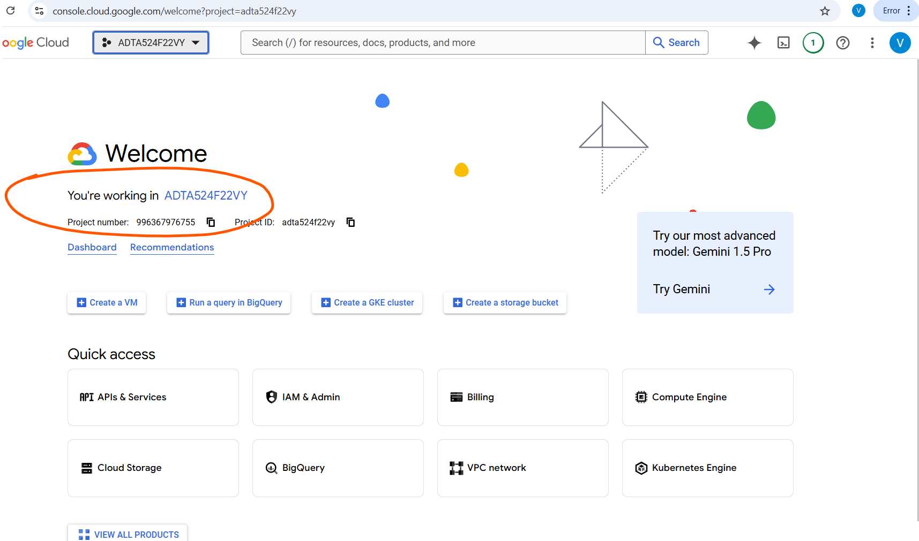
Data storage and pipelines
Step 1:Setting up the GCP project environment
Setup a GCP project which will hold all of the tasks and analysis.

Slide 6
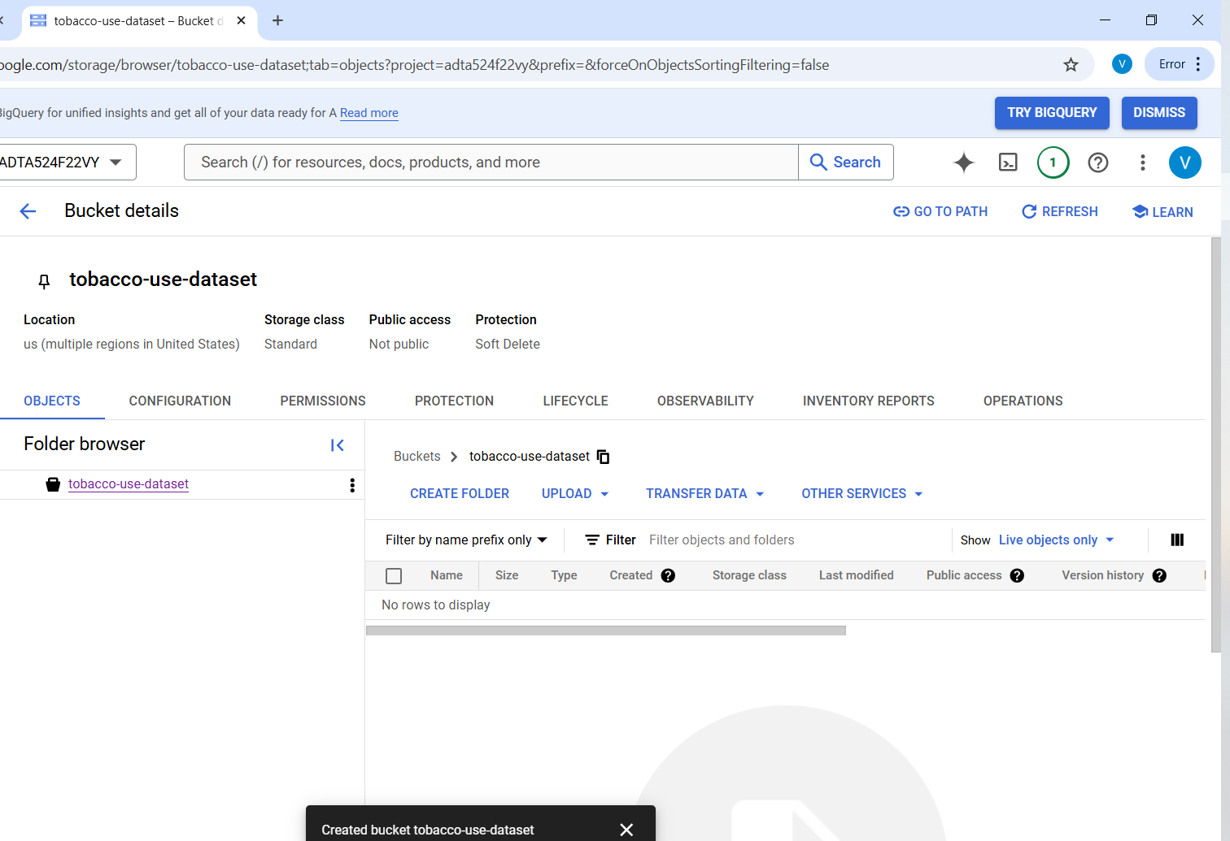
Cloud Storage
Step 2:Configuring the google cloud storage
Setting up the storage bucket for efficient data storage.
We created the bucket named “tobacco-use-dataset”.
This also involved setting up the appropriate region and permission for team access.

Slide 7
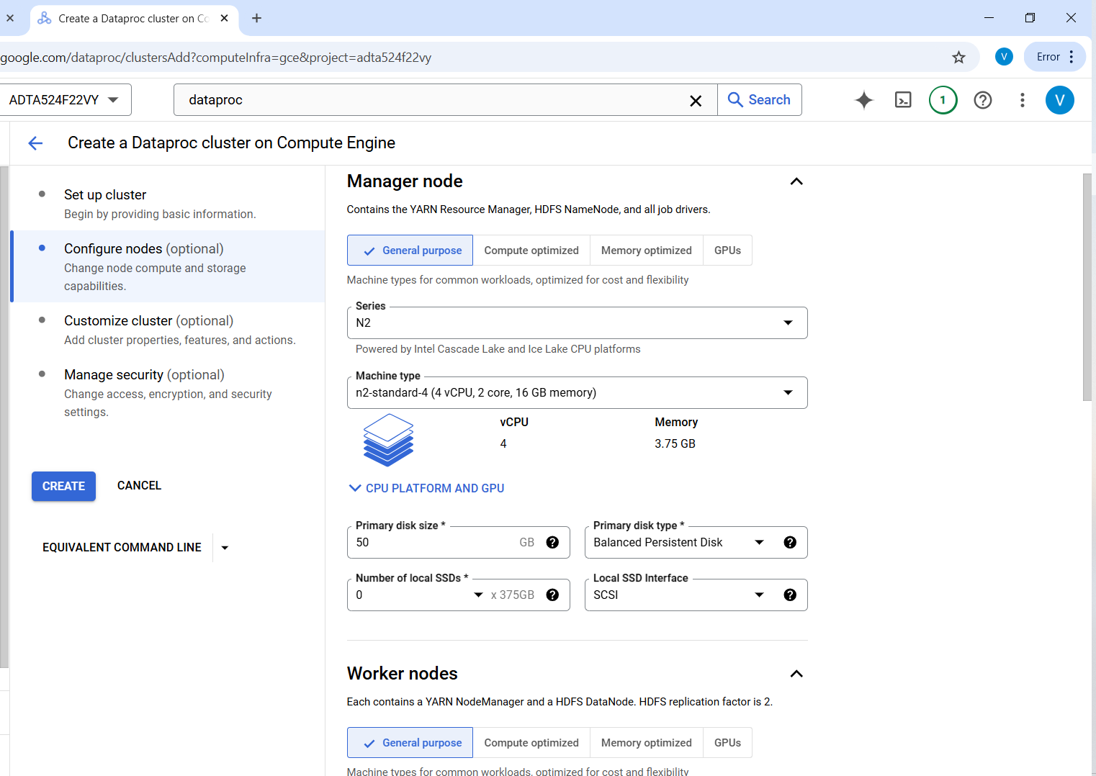
DataProc Cluster
Step 3:Setting up the Hadoop ecosystem
It was to manage and analyze large dataset effectively.
The name of the cluster is tobacco-use-Hadoop-cluster.
The screenshot indictaes how the node and worker configuration works.

Slide 8
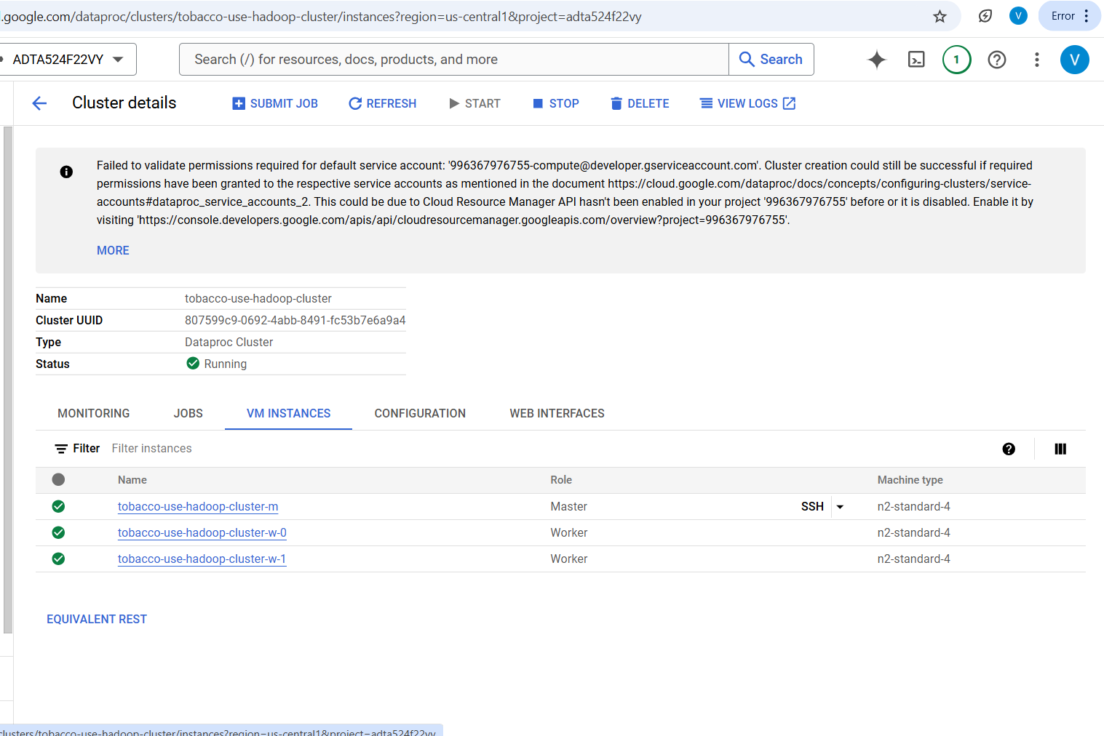
Data Processing
The final cluster created with all hive and spark services enabled by default in dataproc for further data processing.

Slide 9
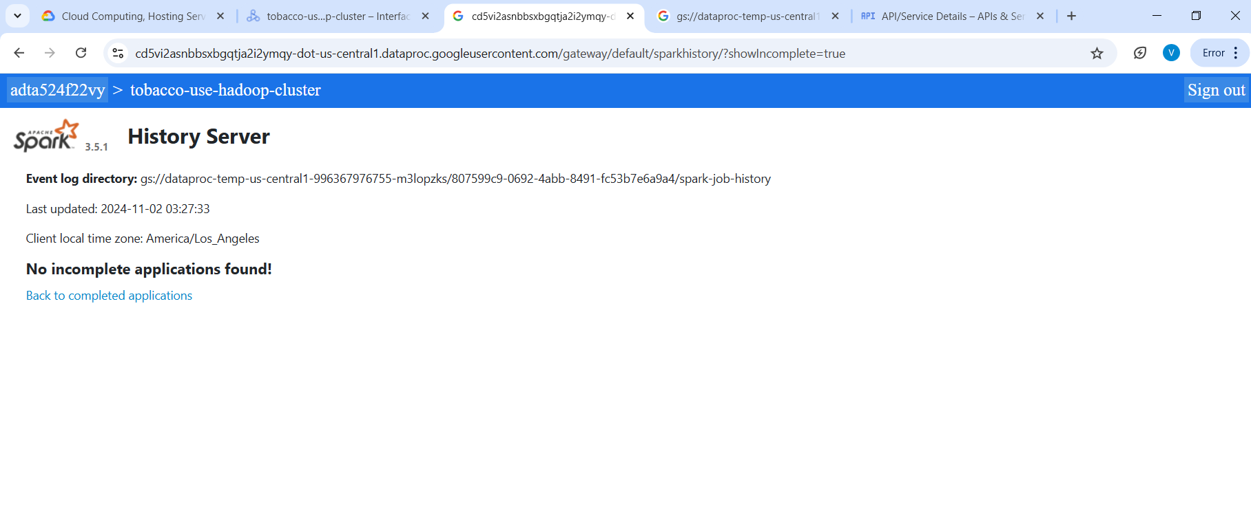
Web Interface
We used the Spark History Server which is a web interface.
This monitors and reviews Spark jobs status and performance.
This tool allows us to analyze the details of job executions, read error messages, tune future jobs by seeing resource usage and job running time.

Slide 10
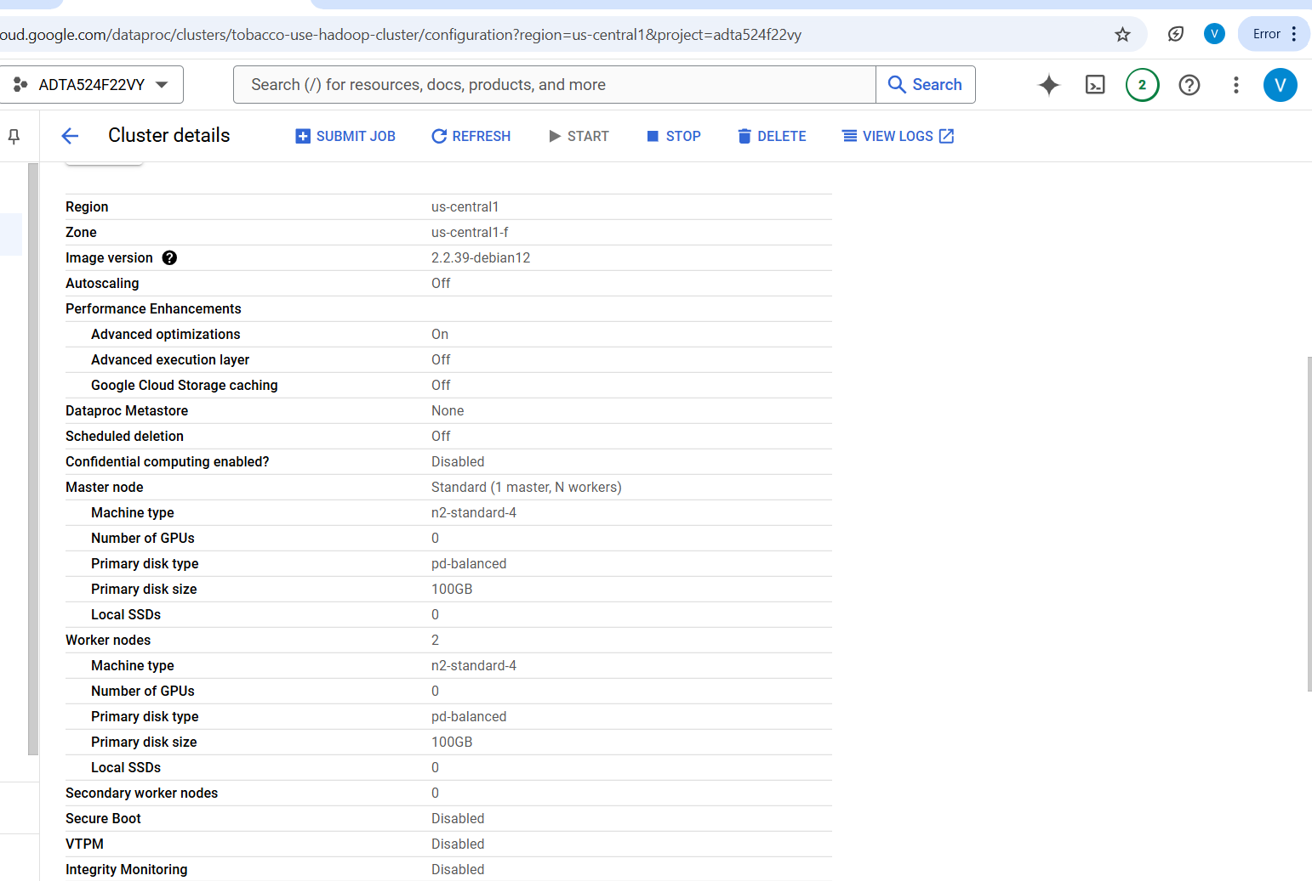
Hadoop Ecosystem
This was the overall configuration of the Hadoop ecosystem

Slide 11
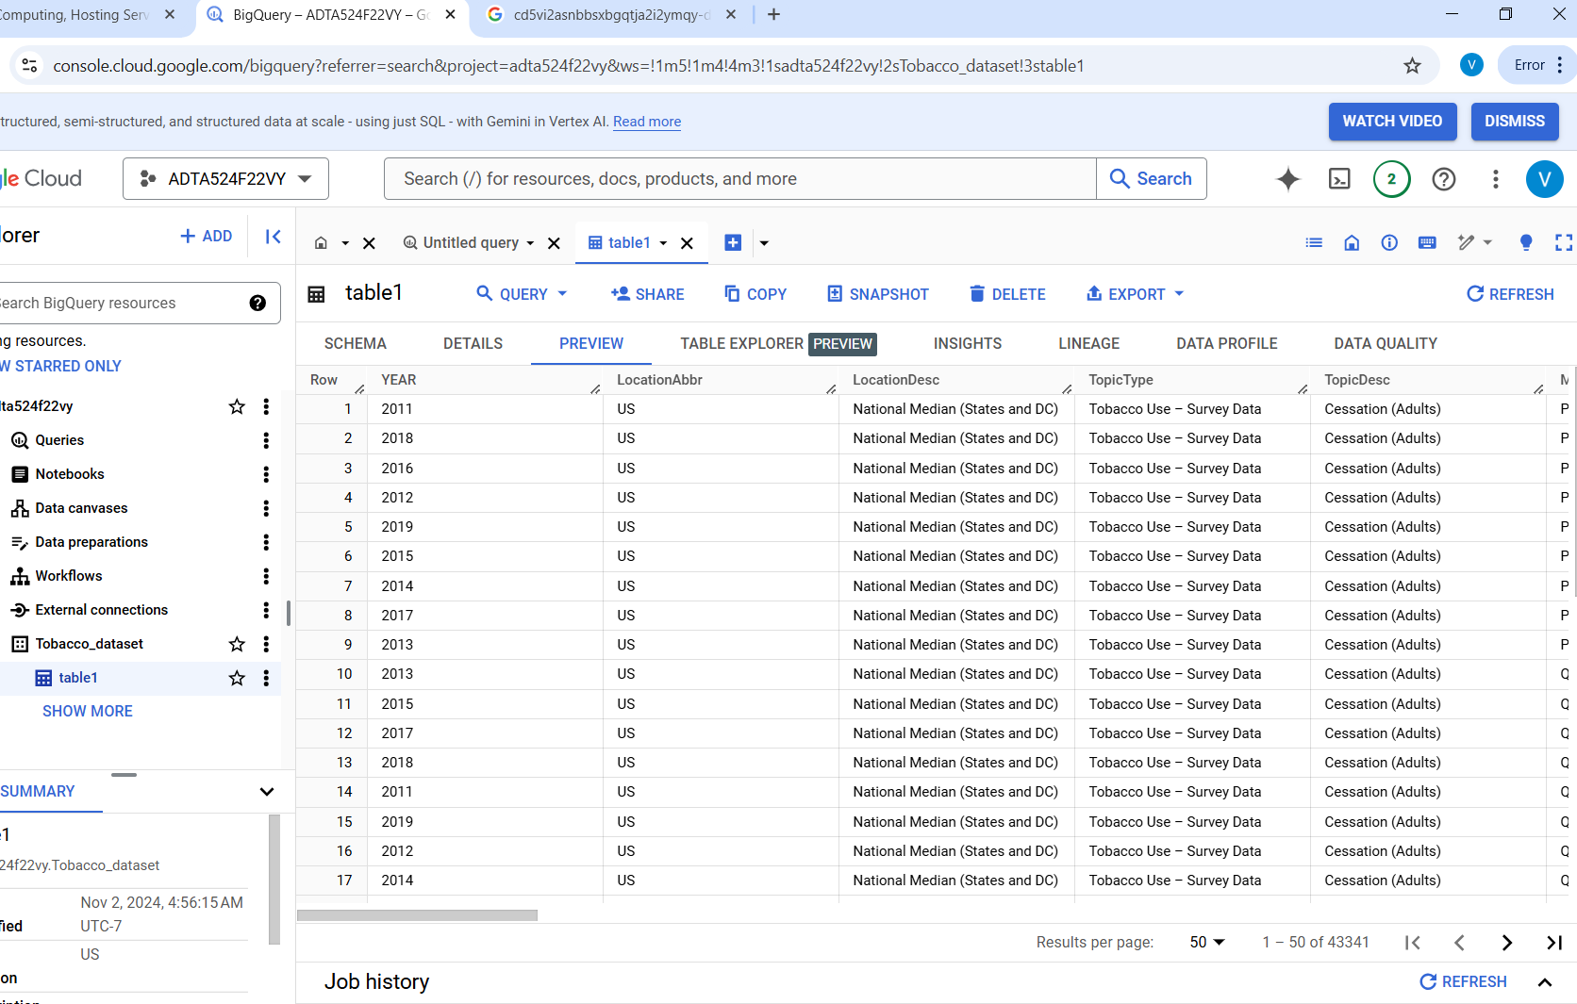
Query for static dataset
Step 4: Creating dataset and table in Big query for static dataset
Created a dataset and table.
Data was ingested for further preprocessing and analysis.
The table preview for the Tobacco dataset.

Slide 12
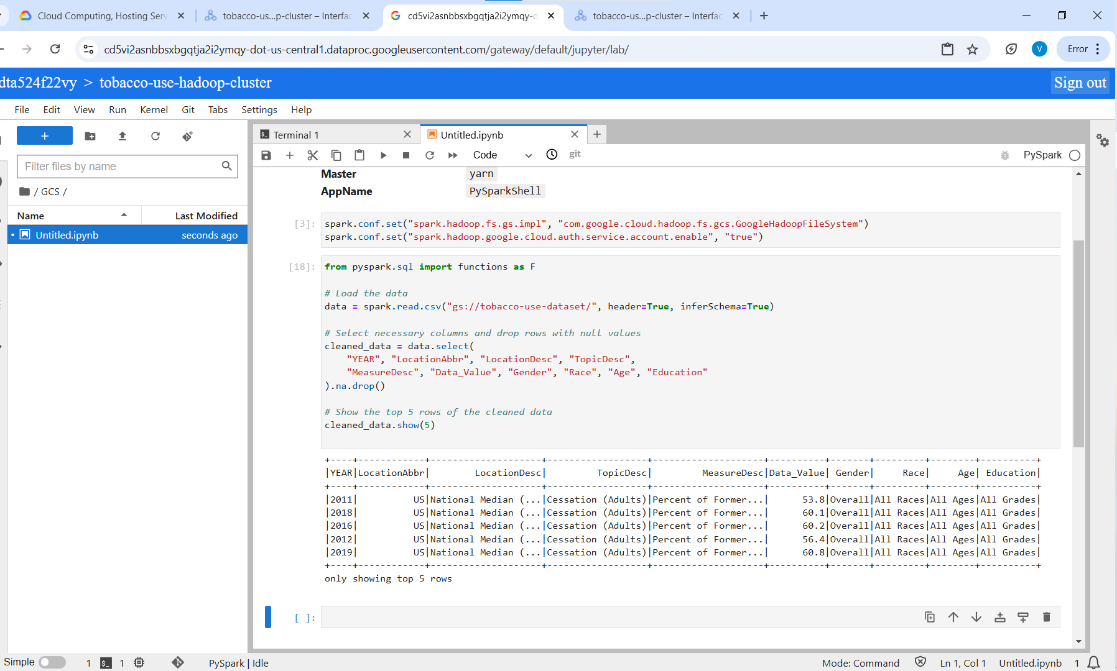
Data Cleaning
We used spark in data cleaning and filtering all the relevant columns using this code.

Slide 13
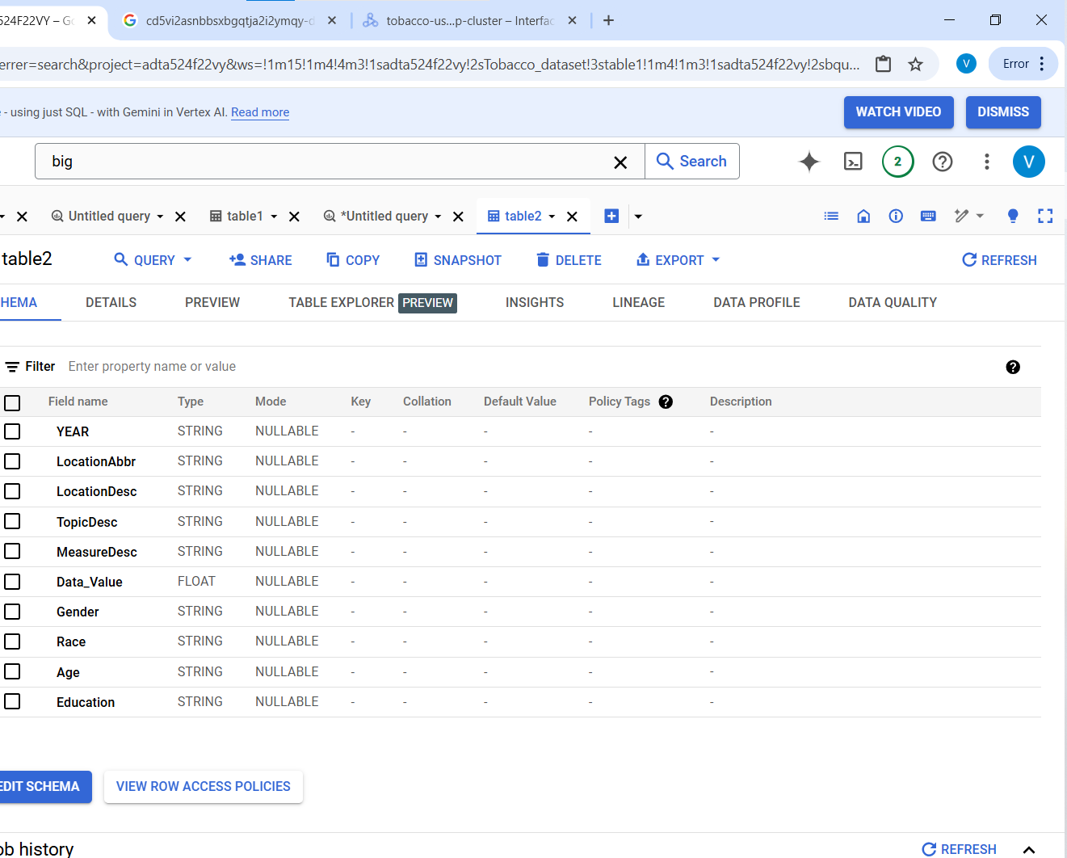
Data Preprocessing
Step 5: Advanced data preprocessing and analysis using Big query
The first process was to filter out all unnecessary columns and remove all null values.
Then we created a new table in bigquery.
Store the new cleaned data for further analysis.
The new schema for the cleaned table.

Slide 14
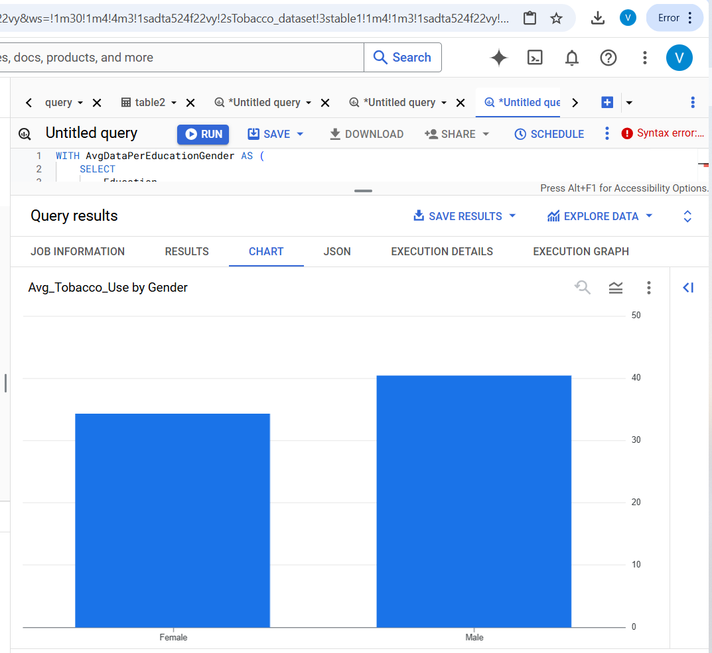
Data Analysis by Gender
Step 7: Data analysis
The query calculates the average Data Value (amount of tobacco used), groups by Education and Gender.
Results show that at all levels of education, males have consistently higher rates of tobacco use than females.

Slide 15
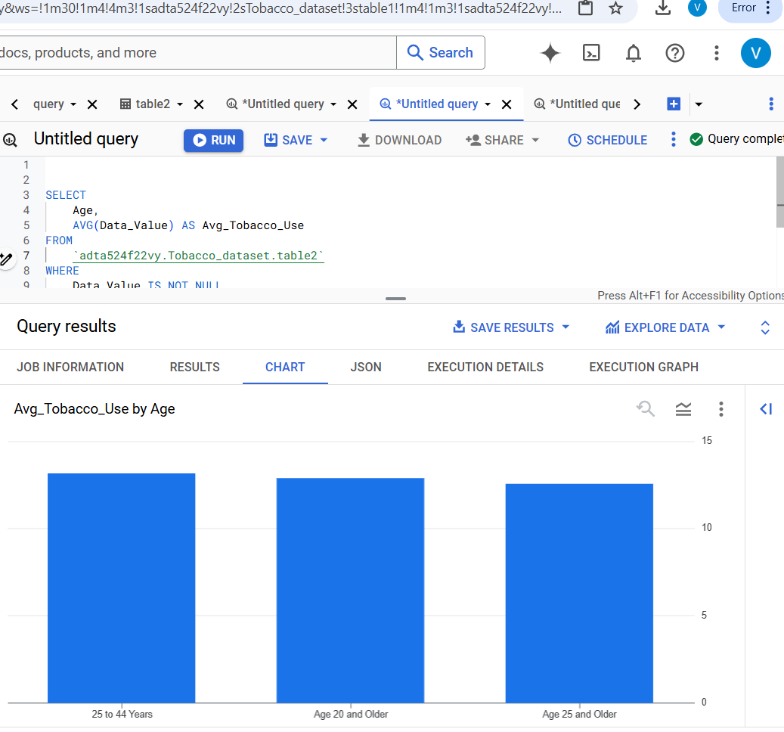
Data Analysis by age
The analysis was to determine the highest the top three with highest tobacco use.
The age groups reveals that adults in the age group bracket of 25 to 44 years consume tobacco at the highest average rates.

Slide 16
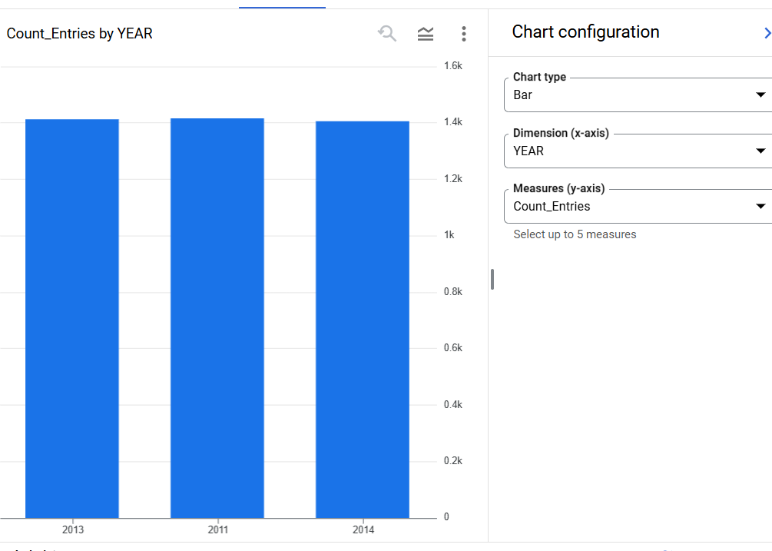
Data Analysis by year
The other insight was the top three years with the highest number of tobacco usage.
The relatively stable average tobacco use over these three years suggests a persistent trend of consumption.

Slide 17

Conclusion
Tobacco use data, which includes all the trends and patterns characteristics across various demographic and year groups, is analyzed in a comprehensive way.
To further investigate what may be causing these trends, the data suggests that some years, in 2013, saw peaks of average tobacco consumption.
The findings indicate that tobacco consumption continues to be a persistent public health 'concern' at all levels of education
The data provide insights into variations in tobacco use, by race and by age, that can help shape tailored prevention.
It might also help guide the timing of public health campaigns based on tobacco consumption patterns by season.

Slide 18

References
Centers for Disease Control and Prevention. (2021). State-specific patterns of cigarette smoking, smokeless tobacco use, and e-cigarette use among adults—United States, 2016. Morbidity and Mortality Weekly Report, 66(3), 120-126. https://doi.org/10.15585/mmwr.mm6603a2
Lee, J. M., & Hager, L. (2021). Trends in tobacco product use among U.S. high school students: 2011-2019. Preventive Medicine, 145, 106432. https://doi.org/10.1016/j.ypmed.2021.106432
https://healthdata.gov/browse?q=Behavioral+Risk+Factor+Surveillance+System&sortBy=relevance&page=1&pageSize=20

